Slide 1

Desarrollo de un Sistema Web Integrado para la Gestión y Seguimiento de Pruebas Metrológicas
3330 - Querétaro

Slide 2
Agenda
Presentación personal
Objetivo
A3 (estructura)
Evidencias (videos, fotos, listas , todo el fundamento)
Resultados
Conclusiones y recomendaciones
2
8
11
14
15
17

Slide 3

Presentación
Reseña
Nombre: Mariela Reyes Camo
Practicante
Área: IT
Estudiante de Ingeniería en Sistemas Computacionales en el Instituto Tecnológico de Querétaro, actualmente cursando el octavo semestre. Desde enero de 2024, me desempeño como practicante en el área de IT en Grammer, donde he podido aplicar mis conocimientos en tecnologías de la información en un entorno profesional.
Mi experiencia incluye atención al cliente, gestión de proyectos y liderazgo de equipos, habilidades que he desarrollado a lo largo de mis estudios y experiencia profesional. Estoy comprometida con el aprendizaje continuo y la mejora constante, buscando siempre soluciones efectivas y eficientes en cada desafío que enfrento.

Slide 4
2. Objetivo
Objetivo General:
Desarrollar e implementar un sistema web para gestionar solicitudes de pruebas metrológicas, mejorando la eficiencia operativa y calidad del servicio.
Objetivos Específicos:
Automatizar el registro, modificación, consulta y cancelación de solicitudes.
Crear un panel de control con indicadores, gráficos y reportes mensuales.
Implementar notificaciones automáticas por correo electrónico.
Facilitar la gestión de roles, permisos, clientes y plataformas.

Slide 5
Fotografía del proyecto
A3
Caso de Negocio:
Objetivos específicos:
Contexto: El laboratorio enfrenta desafíos significativos en la gestión de solicitudes de pruebas metrológicas debido a procesos manuales, lo que resulta en errores, retrasos operativos y tiempos prolongados de respuesta.
Problema: La falta de automatización en el registro y seguimiento de solicitudes, junto con la dispersión de información, crea ineficiencias operativas y riesgos de errores humanos.
Impacto: La ineficiencia en la gestión de las solicitudes afecta la productividad del laboratorio y disminuye la capacidad del laboratorio para adaptarse a las demandas del mercado.
Automatizar el proceso de gestión de solicitudes: Crear una plataforma que elimine la necesidad de procesos manuales y reduzca la carga administrativa.
Mejorar la visibilidad y coordinación: Implementar una solución centralizada que facilite la colaboración entre el equipo del laboratorio.
Aumentar la eficiencia operativa: Reducir los tiempos de respuesta y mejorar la precisión en la entrada de datos.
Condiciones actuales:
Principales actividades Kaizen:
Procesos manuales: La gestión de solicitudes se realiza principalmente en papel.
Visibilidad limitada: La información está dispersa, lo que dificulta el seguimiento y la priorización de las solicitudes.
Riesgo de errores: La entrada manual de datos es propensa a errores, lo que compromete la calidad y el correcto seguimiento de la resolución.
Falta de coordinación: La comunicación entre los miembros del equipo no está optimizada, lo que puede llevar a retrasos.
Encargado | Actividades | Fechas
Mariela Reyes | Mapeo del flujo de trabajo
Mariela Reyes | Desarrollo funcional de la app web
Adrián Aragón | Testing de pruebas iniciales
Mariela Reyes | Elaboración de manuales
Equipo de metrología | Testing en app
Mariela Reyes | Correcciones de la app

Slide 6


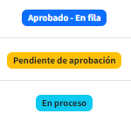
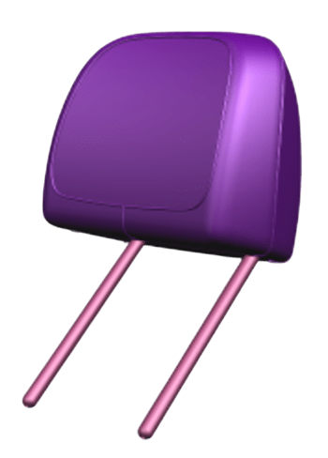
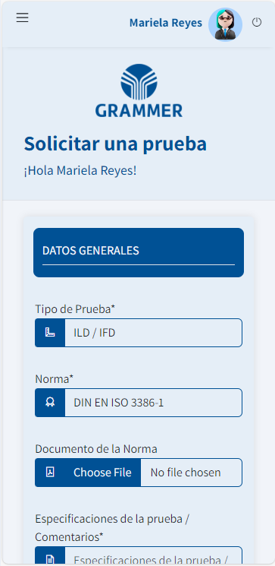




MetroTickets
Proceso del sistema.
Realización de la solicitud
El equipo de laboratorio revisa y aprueba la solicitud
Se atiende la solicitud
El solicitante recibe los reportes

Slide 7
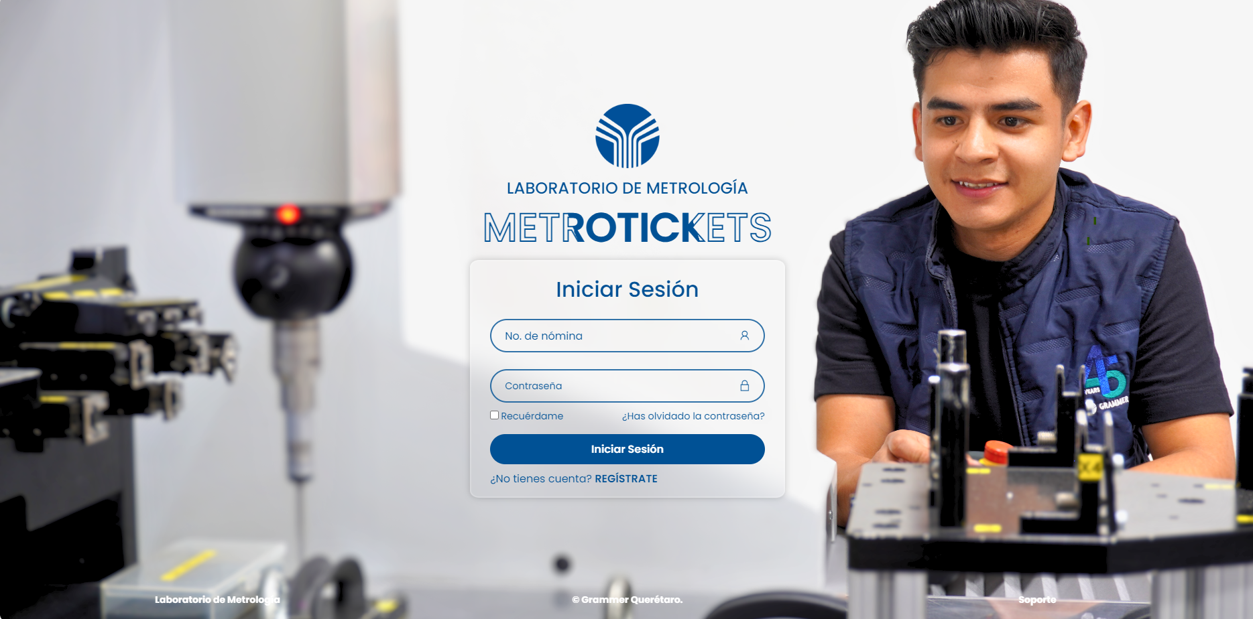
KPI’s
MetroTickets
Tiempo promedio de respuesta a solicitudes: Tiempo que tarda el laboratorio en responder a una solicitud desde su recepción.
Disponibilidad de Información. Antes, solo se disponía del 10% de la información de las solicitudes; ahora, el sistema en la nube permite acceder al 100% de la información, junto con datos adicionales para su consulta.
Reducción de Errores. Tasa de errores en el registro de solicitudes: Porcentaje de solicitudes registradas que contienen errores (ej. datos incorrectos, solicitudes duplicadas).
Ahorro.
Índice de satisfacción del cliente: Medido a través de encuestas post-servicio para evaluar la percepción del cliente sobre la calidad del servicio.
Porcentaje de solicitudes automatizadas: Proporción de solicitudes que son procesadas automáticamente en comparación con las que se manejan manualmente.
.

Slide 8
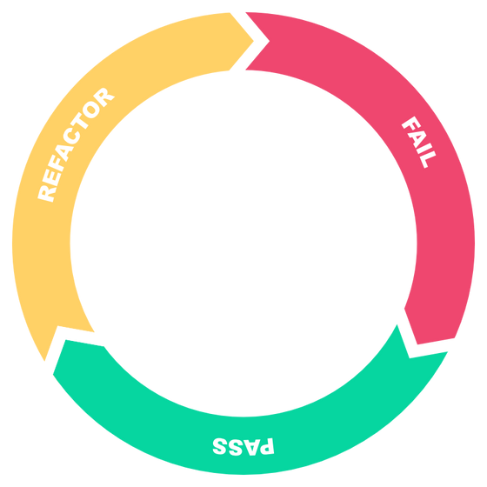
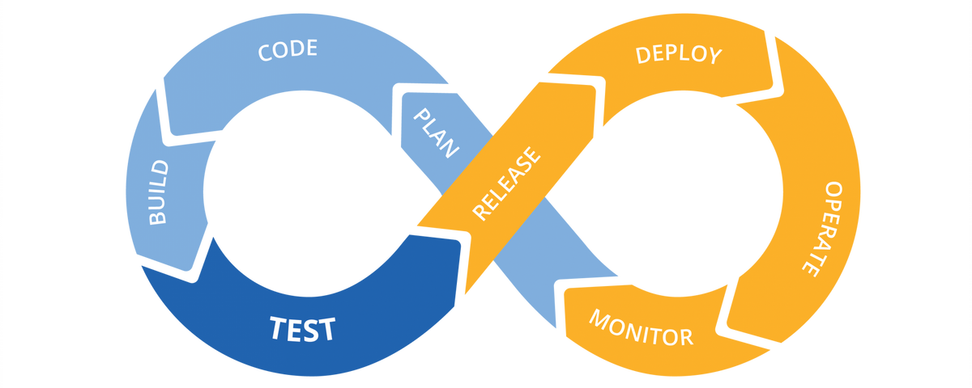
Sistema de bonos de salida
Herramientas utilizadas
CI / CD
TDD
Integración continua / Desarrollo continuo
Desarrollo guiado por pruebas.

Slide 9




Our Mission
Corporate Presentation
We deliver what matters.
GRAMMER aims to be the world's leading supplier of seating solutions for commercial vehicles and interior solutions for the automotive industry. Our products set the standard in ergonomics, comfort and sustainability. Customers and partners in the OEM business as well as in the aftermarket perceive us as innovation and quality leader and appreciate the great support we provide.
Innovation
Customer Focus
Sustainability
Notes:
OUR MISSION
We deliver what matters
GRAMMER aims to be the world's leading supplier of seating solutions for commercial vehicles and interior solutions for the automotive industry. Our products set the standard in ergonomics, comfort and sustainability. Customers and partners in the OEM business as well as in the aftermarket clearly perceive us as innovation and quality leaders and appreciate the great support we provide.
Innovation
We are constantly looking for new ideas to open up competitive advantages for our customers and develop highly innovative, human centered and sustainable solutions that set the standards in their class.
Customer focus
As a strong, trusted partner for customers all over the world, we provide best possible global and local support and tailormade solutions that meet their individual needs. We are committed to top quality in all we do and continuously work to become better.
Sustainability
In everything we do we care for people and our planet. This is visible in our products, processes and how we do business.

Slide 10

Fast Facts 2021
Corporate Presentation
14,000+
Employees
on average
1,9+ billion+
EUR
revenue
EUR
revenue
46 locations
in
19 countrys
around the world
21%
APAC
65%
Automotive
53%
EMEA
26%
Americas
35%
Commercial
Vehicles
Revenue by regions
Revenue by divisions
Notes:
GRAMMER is a global manufacturer in the automotive and commercial vehicle industries. GRAMMER serves its customers worldwide with a workforce of around 14,000 employees at 46 locations in 19 countries. In 2021 the company achieved a revenue of around 1.9 billion euros.
With our two divisions Automotive and Commercial Vehicles we have a strong base. Last year the Automotive division contributed around 65% to the total revenue, the Commercial Vehicles division 35%.
In terms of the revenues we strive for a balance between the three regions EMEA, Americas and APAC. Therefore, APAC is currently the fastest growing region. This growth goes hand in hand with the opening of two new plants in Ningbo and Shenyang, China.

Slide 11
Organization Structure
Corporate Presentation
Executive Board
Region Americas
Region EMEA
Region APAC
Division Automotive
Division Commercial Vehicles
Group Functions (e.g. HR, Accounting, Marketing, ... )
Notes:
GRAMMER can look back on over 100 years of history. From the beginnings of a saddlery, founded by Willibald Grammer in 1880, to a globally active supplier to the automotive and commercial vehicles industry.
In 1954 GRAMMER became a stock corporation and in 1970 the company entered the agricultural machinery sector. In 1982 truck and bus seating solutions were added, followed by entry into the automotive sector with solutions for car interiors. Our seat portfolio expanded once again in 1990 to include passenger seats for trains and buses. With the IPO in 1996, further globalization and the growth to today's company began. With targeted takeovers and joint ventures in EMEA, Americas and China, GRAMMER further expanded its market position in the world regions and offers its growing number of customers worldwide an innovative and comprehensive product portfolio.

Slide 12
Milestones
Corporate Presentation
1990
Entry into the rail & bus interior sector
2017
Strategic partnership with Ningbo Jifeng Auto Parts
2021
Joint Venture for truck seats with FAW Group, China
1954
GRAMMER AG incorporated
2015
Takeover of REUM Group
1982
Entry into the bus and truck segment
2011
Entry into the electronics segment
2018
R&D Joint Venture with Allygrow, India
1996
IPO of GRAMMER AG
2016
Joint Venture for truck seats with Shaanxi, China
1970
Entry into the agricultural sector
2018
Takeover of Toledo Molding &
Die Inc., USA
1880
Willibald Grammer founds a saddlery in Amberg
1985
Entry into the passenger car interior sector
2019
Joint Venture with FAWSN Group, China
2014
Takeover of Nectec s.r.o., Czech Republic
Notes:
GRAMMER can look back on over 100 years of history. From the beginnings of a saddlery, founded by Willibald Grammer in 1880, to a globally active supplier to the automotive and commercial vehicles industry.
In 1954 GRAMMER became a stock corporation and in 1970 the company entered the agricultural machinery sector. In 1982 truck and bus seating solutions were added, followed by entry into the automotive sector with solutions for car interiors. Our seat portfolio expanded once again in 1990 to include passenger seats for trains and buses. With the IPO in 1996, further globalization and the growth to today's company began. With targeted takeovers and joint ventures in EMEA, Americas and China, GRAMMER further expanded its market position in the world regions and offers its growing number of customers worldwide an innovative and comprehensive product portfolio.

Slide 13






Sustainability for our future
Corporate Presentation
Corporate governance - Code of conduct for all employees Innovative and sustainable product solutions
Environment - Green Company
Supply Chain - Responsible Supplier Management
Employees & Community
Notes:
As a globally active company, we take responsibility and actively contribute to the realization of global sustainability goals.
5 focus areas in which we assume corporate responsibility with our core business:
1. Corporate governance
Code of Conduct - new code of conduct for all employees
Compliance
2. Innovative and sustainable product solutions
We are researching innovative and sustainable product solutions in order to be able to offer our customers environmentally friendly alternatives in the future.
3. Environment - Green Company
Reduce emissions We aim to meet the 1.5 degree target of the Paris Climate Agreement and reduce greenhouse gases: CO2 emission reduction by at least 50% by 2030 (base year 2019) Other emissions such as VOC (Volatile Organic Compounds) or e.g. noise are reduced to a minimum.
Producing green products We research innovative and sustainable product solutions in order to be able to offer our customers environmentally friendly alternatives in the future.
Efficient use of materials We design the use of our production and non-production materials as efficiently as possible throughout the entire product life cycle. Responsible handling of critical materials is a matter of course.
Reduce energy consumption and promote natural resources We aim to reduce energy consumption within our processes, promote the use of renewable energy sources and encourage the sparing use of natural resources.
Reduce waste and increase recycling We aim to reduce waste, minimize hazardous waste materials, increase recycling of waste and ensure that appropriate disposal and recycling methods are used.
4. Supply chain - responsible supplier management
Identify and optimize carbon footprint in the supply chain
Supplier Code of Conduct - New code of conduct for all suppliers Target: 100 % of global suppliers confirm GRAMMER „Supplier Code of Conduct".
Working conditions and human rights Target: Our employees are continuously sensitized to human rights aspects as part of compliance training (e-learning)
5. Employees & community
Employee development/talent management and employee satisfaction
Promoting diversity
Increase proportion of women in management positions to at least 20% by 2030

Slide 14
Sustainability for our future
Corporate Presentation
We aim to achieve the 1.5 degree target of the climate agreement - CO2 emissions neutrality by 2040.
Exercise corporate due diligence for fair working conditions and human rights.
Diversity & equal opportunities - increase share of women in management positions to 20% by 2030
Measures for 2022
Use of renewable energies
Development of sustainable product solutions
Increase energy and material efficiency
Waste prevention & recycling
Notes:
Long-term goals
Emissions reduction: We aim to achieve the 1.5 degree target of the Paris Climate Agreement. CO2 emissions neutrality by 2040 (Scope 1 & 2) Interim targets: CO2 emissions reduction of at least 25% by 2025 & CO2 emission reduction of at least 50% by 2030 (base year 2019). Material efficiency: Reduction of material used by at least 15% by 2030.
Exercise corporate due diligence for fair working conditions and human rights
Diversity and equal opportunities: increase proportion of women in management positions to at least 20% by 2030
Measures for 2022
Use of renewable energies (green electricity)
Development of sustainable product solutions
Increase energy and material efficiency
Waste prevention & recycling Avoidance of disposable packaging in logistics Recycling regranulation strategy

Slide 15
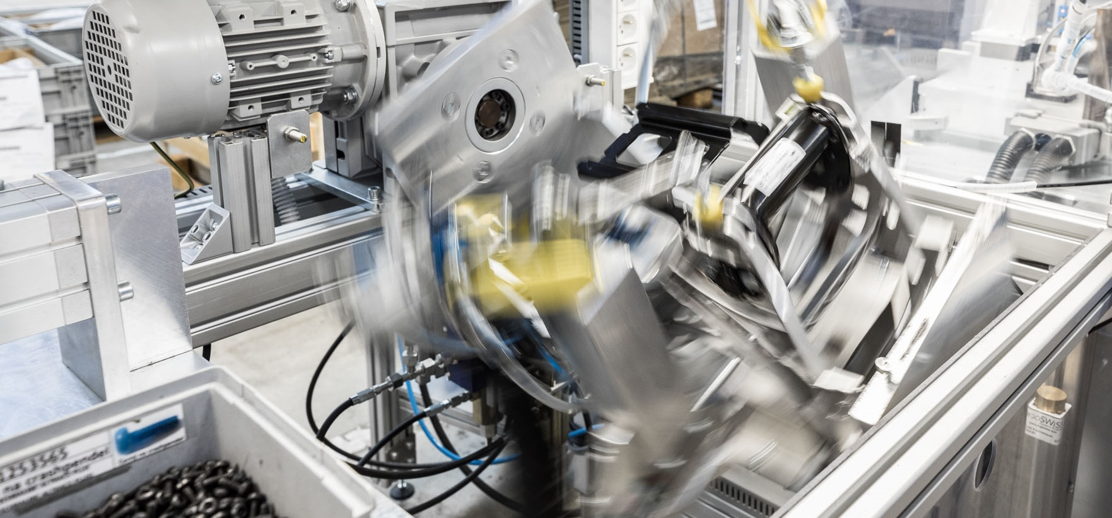
Manufacturing Technologies
Corporate Presentation
Assembly
Cut & sew
Metal processing
Tubes & frames
Foaming
Surface treatment
Joining technology (plastics)
Lamination
Injection moulding
Vacuum thermoforming processes for glass applications
Notes:
Assembly (incl. screwing & clipsing) : Consoles, Armrests, Headrests, Suspensions, Interior Components, Functional Components
Cut & sew : Leather & fabric cutting, manual & automatic sewing
Metal processing : Punching & pressing, bending, welding, metalforming
Tubes & frames : Bending & notching, weldings headrest tubes / frames
Foaming : Mono hardness (cold foaming), front foaming, INSITU, backfoaming, hard coating, integral foaming, PUR formulation
Surface treatment : Metal powder painting, KTL painting, plastic painintg with robots, flocking
Joining technology (plastics) : Hot plate welding, ultrasonic welding, vibration welding, ultrasonic riveting, hot air riveting
Lamination : Vacuum & press lamination
Injection moulding : Standard, mycell, 2-components, blow moulding
Vacuum thermoforming processes for glass applications

Slide 16
Global Footprint
GRAMMER Locations
18%
34%
82%
66%
26% Americas
15 Locations
~ 4,700 Employees
~ 518m €
47%
53%
21% APAC
11 Locations
~ 1,400 Employees
~ 406m €
53% EMEA
20 Locations
~ 7,500 Employees
~ 1.062m €
Automotive
Commercial Vehicles
From the Annual Report; relative to 2021/12/31
Notes:
The organizational structure of the GRAMMER Group was fundamentally changed in 2020. Our goal was to give the three regions – Americas, EMEA and APAC – greater responsibility and decision-making powers. As a result, our global locations guarantee greater customer proximity and flexibility. Looking ahead, this will enable GRAMMER to respond faser to diffenrent market challenges.

Slide 17

Locations EMEA
GRAMMER Locations
GERMANY
Amberg
Bremen
Ebermannsdorf
Hardheim
Kümmersbruck
Raststatt
Schmölln
Trusetal
Ursensollen (HQ)
Wörth
Zwickau
UK
Walsall
BELGIUM
Aartselaar
Geel
CZECH REPUBLIC
Ceska Lipa
Most
Plana
Tachov
Žatec
FRANCE
Limonest
POLAND
Bielsko Biala
Sosnowiec
SLOVENIA
Slovenj Gradec
SERBIA
Aleksinac
SOUTH AFRICA
Johannesburg
ITALY
Jesi
BULGARIA
Trudovets
TURKEY
Bursa
South Africa

Slide 18
Locations APAC
GRAMMER Locations
CHINA
Bejing
Changchun
Ningbo
Shaanxi
Shanghai
Shenyang
Tianjin
JAPAN
Tokyo
INDIA
Pune

Slide 19
Locations AMERCIAS
GRAMMER Locations
USA
Beloit, WI
Bowling Green, OH
Delphos, OH
Fayetteville, TN
Hudson, WI
Plymouth, MI
Shannon, MS
Tiffin, OH
Toledo, OH
Troy, MI
BRAZIL
Atibaia, São Paulo
MEXICO
Celaya
Querétaro
Tetla
ARGENTINIA
Buenos Aires
South America

Slide 20

Division Commercial Vehicles

Slide 21
Organization Structure
Division Commercial Vehicles
Executive Board
Division Commercial Vehicles
Product Market Segment
Off-Road
Product Market Segment
Rail & Road
Product Market Segment
Aftermarket
Business Development
Region Americas
Region EMEA
Region APAC
Notes:
GRAMMER can look back on over 100 years of history. From the beginnings of a saddlery, founded by Willibald Grammer in 1880, to a globally active supplier to the automotive and commercial vehicles industry.
In 1954 GRAMMER became a stock corporation and in 1970 the company entered the agricultural machinery sector. In 1982 truck and bus seating solutions were added, followed by entry into the automotive sector with solutions for car interiors. Our seat portfolio expanded once again in 1990 to include passenger seats for trains and buses. With the IPO in 1996, further globalization and the growth to today's company began. With targeted takeovers and joint ventures in EMEA, Americas and China, GRAMMER further expanded its market position in the world regions and offers its growing number of customers worldwide an innovative and comprehensive product portfolio.

Slide 22



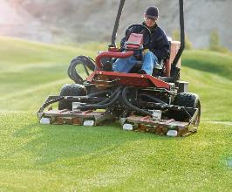
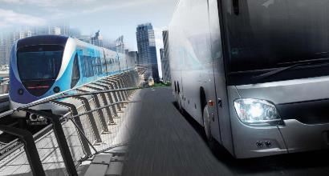

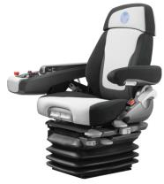
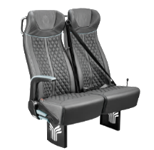
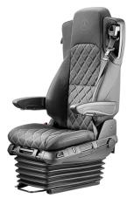
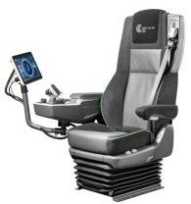
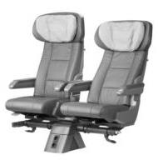
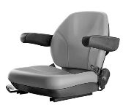
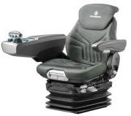
Our Business
Division Commercial Vehicles
Off-Road
Rail & Road
Driver Seats, Trainer Seats, Multi-functional Armrests
Driver- and Co-Driver Seats
Customer- and application specific solution, based on modular seat system

Slide 23








Our Sales-Channel Setup
Division Commercial Vehicles
Off-Road
Rail & Road
Aftermarket
Driver Seats, Trainer Seats, Multi-functional Armrests
Driver- and Co-Driver Seats
Off-Road & Road
OEM
Dealer
Small OEM
End- Customer

Slide 24
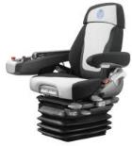
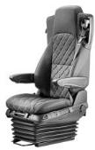
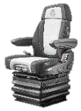
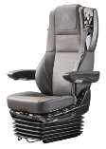
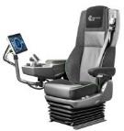

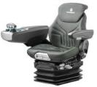

Our Sales-Channel Setup
Division Commercial Vehicles
OEM
Small OEM/OES
End-Customer
Dealer
PMS Off-Road
PMS Rail & Road
PMS Aftermarket
Customer- and application specific solution, based on modular seat system
Adapted off-the-shelf portfolio

Slide 25
Our CV Footprint
Division Commercial Vehicles
AMERICAS
Atibaia
Delphos
Hudson
London (GRA-MAG)
San Martin
Tupelo
CHINA
Changchun
Ningbo
Shaanxi
Shanghai
Tianjin
ROW
Tokyo
Pune (Allygram)
EMEA
Aartselaar
Amberg
Bloxwich
Bursa
Jesi
Limonest
Tachov
Zatec
More than 50 plants, sales and logistic entities
Thereof more than 20 entities supporting CV

Slide 26

Our Services
Division Commercial Vehicles
GRAMMER enjoys a leading global market position for driver and passenger seats in the commercial vehicle sector. Beside a wide range of solutions, we also offer extensive experience of both consulting and implementation.
As a leading innovator, we invest a great deal in research and development, yet also in our consulting and service offering. This is what characterizes the high added value of GRAMMER solutions.
We are at home in 20 countries and represented worldwide together with our sales partners. This secures the global availability of our products and comprehensive local expertise with short distances to customers.
We offer the same high quality standards in our solutions and services across the globe. We also work hard every day to become even better.

Slide 27
Division Commercial Vehicles
Products

Slide 28
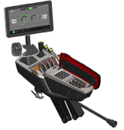
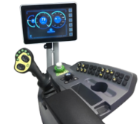
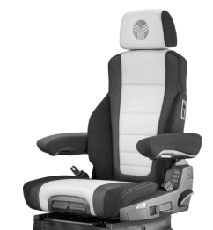
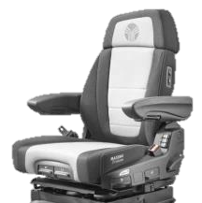



Modular Structure
Division Commercial Vehicles
Off-Road product family
Diversity of Options:
Seat covers
Armrests
Backrest extension
Heating systems
Climate control
Swivel adapter
etc.
→ The right seat for every application
MFA
MFA
Seattop
Seattop
Suspension
Suspension

Slide 29
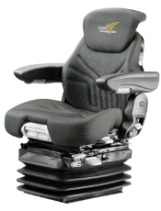
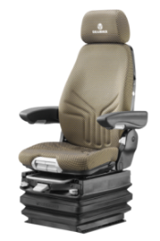
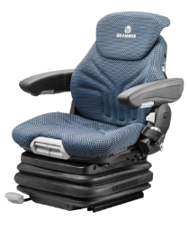
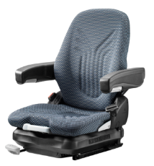
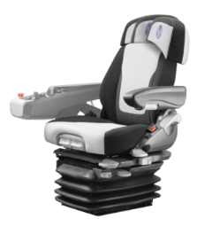
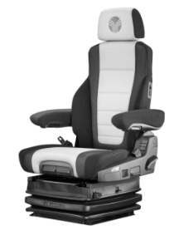
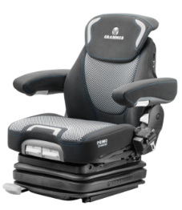
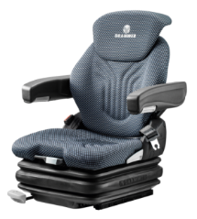
Product Portfolio Offroad
Division Commercial Vehicles
Offroad product family
Agriculture
Construction
Material Handling
Turf
High-end Product
High-end Product
High-end Product
High-end Product
Entry Product
Entry Product
Entry Product
Entry Product

Slide 30
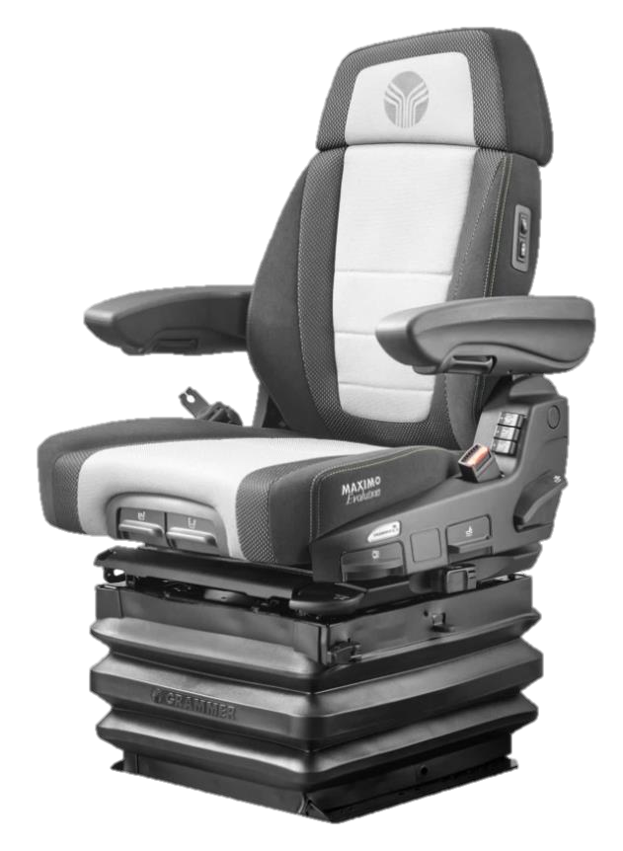
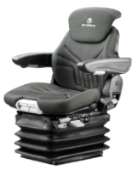
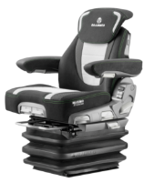












Driver seats for agricultural machinery (Example)
Division Commercial Vehicles
Offroad
MSG 95 Series
Agriculture
Lateral Suspension
Pneumatic Suspension
Dynamic Damping System
Pneumatic Lumbar Support
Adjustable Swivel
Electronic Weight Adjustment
Active Climate System
Automatic Shock Absorber
Fore/Aft Isolator
Automatic Positioning System
leaflet
Data sheet

Slide 31
Legal Disclaimer
GRAMMER
By attending the presentation to which this document relates or by accepting this document and not immediately returning it, you agree to be bound to the following limitations:
This presentation and the topics addressed therein have been compiled for discussion purposes only and are not intended to be a comprehensive summary of all business, financial, legal, practical and other aspects or to cover all issues relating to an investment in Grammer AG. A binding commitment will only result from a definitive and binding agreement.
This presentation does not constitute or form part of, and should not be construed as, an offer to sell or a solicitation of an offer to buy or subscribe for any securities and neither this presentation nor anything contained herein shall act as an inducement to enter into or form the basis of, or be relied on in connection with, any offer or contract or commitment whatsoever.
This presentation does not constitute an offer for sale of any securities in the United States. Neither this presentation nor any copy of it may be taken or transmitted in or into the United States of America, its territories or possessions or distributed, directly and indirectly, in the United States of America, its territories and possessions or to U.S. Persons (as such term is defined in Regulation S under the Securities Act). Any failure to comply with this restriction may constitute a violation of U.S. securities laws. Neither this presentation nor any copy of it may be taken or transmitted in or into Australia, Canada or Japan or distributed, directly and indirectly, in Australia, Canada or Japan. The distribution of this presentation in other jurisdictions may be restricted by law and persons into whose possession this presentation comes should inform themselves about, and observe, any such restrictions.
This presentation contains estimates, forecasts and expectations. Such estimates, forecasts and expectations are subject to risks and elements of uncertainty that could result in deviation of actual developments from expected developments. The estimates, forecasts and expectations are only valid at the time of publication and there can be no assurance that future results or events will be consistent with any such estimates, forecasts or expectations. Grammer AG does not intend to update any such estimates, forecasts or expectations and assumes no obligation to do so. Grammer AG does not assume any liability for the statements made.
Neither Grammer AG nor any of its respective directors, officers, or employees nor any other person accept – to the extent legally possible – any liability for any loss howsoever arising from any use of this presentation or its contents or otherwise in connection therewith. Please take appropriate advice before applying anything contained in these materials to specific issues or transactions.
This presentation is confidential and is being supplied to you solely for your information and may not be reproduced, redistributed or passed on to any other person or published, in whole or in part, for any purpose. This presentation or any copy of it may not be distributed to any third party, including the media or the press.

Slide 32


Slide 33




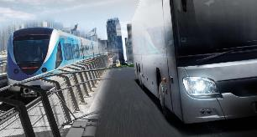

Our Sales-Channel Setup
Division Commercial Vehicles
Off-Road
Rail & Road
Aftermarket
Driver Seats, Trainer Seats, Multi-functional Armrests
Driver- and Co-Driver Seats
Off-Road & Road
Customer- and application specific solution, based on modular seat system

Slide 34
Locations EMEA
GRAMMER Locations
Headline
…
…
…
South Africa

Slide 35
Locations APAC
GRAMMER Locations
Headline
…
…
…

Slide 36
Locations AMERCIAS
GRAMMER Locations
Headline
…
…
…
South America

Slide 37


Location Components for APAC
Grammer Plants
Grammer CH
Beijing
Shanghai
Shenyang
Changchun
Tianjin
Ningbo
Shaanxi
Grammer IN
Pune
CLIENT PLANT
Location 1
Location 2
Location 3
Location 4
Location 5
<
Grammer JAP
Tokyo
1100 km
Highlighted Plant 1
Highlighted Plant 2

Slide 38
Location Components for AMERICAS
Grammer Plants
Grammer USA
City of Hudson, WI
Shannon, MS
Greenville, SC
Troy, MI
Toledo, OH
Bowling Green, OH
Delphos, OH
Tiffin, OH
Plymouth, MI
Fayetteville, TN
Beloit, WI
Jefferson, OH
Grammer MX
Querétaro
Tetla
Celaya
CLIENT PLANT
Location 1
Location 2
Location 3
Location 4
Location 5
Grammer BR
Atibaia
Grammer AR
Buenos Aires
Highlighted Plant 1
Highlighted Plant 2

